Slide 1
Project Assignment
Applied Bioinformatics
Mario L. Martin

Slide 2
Ovweview

Slide 3
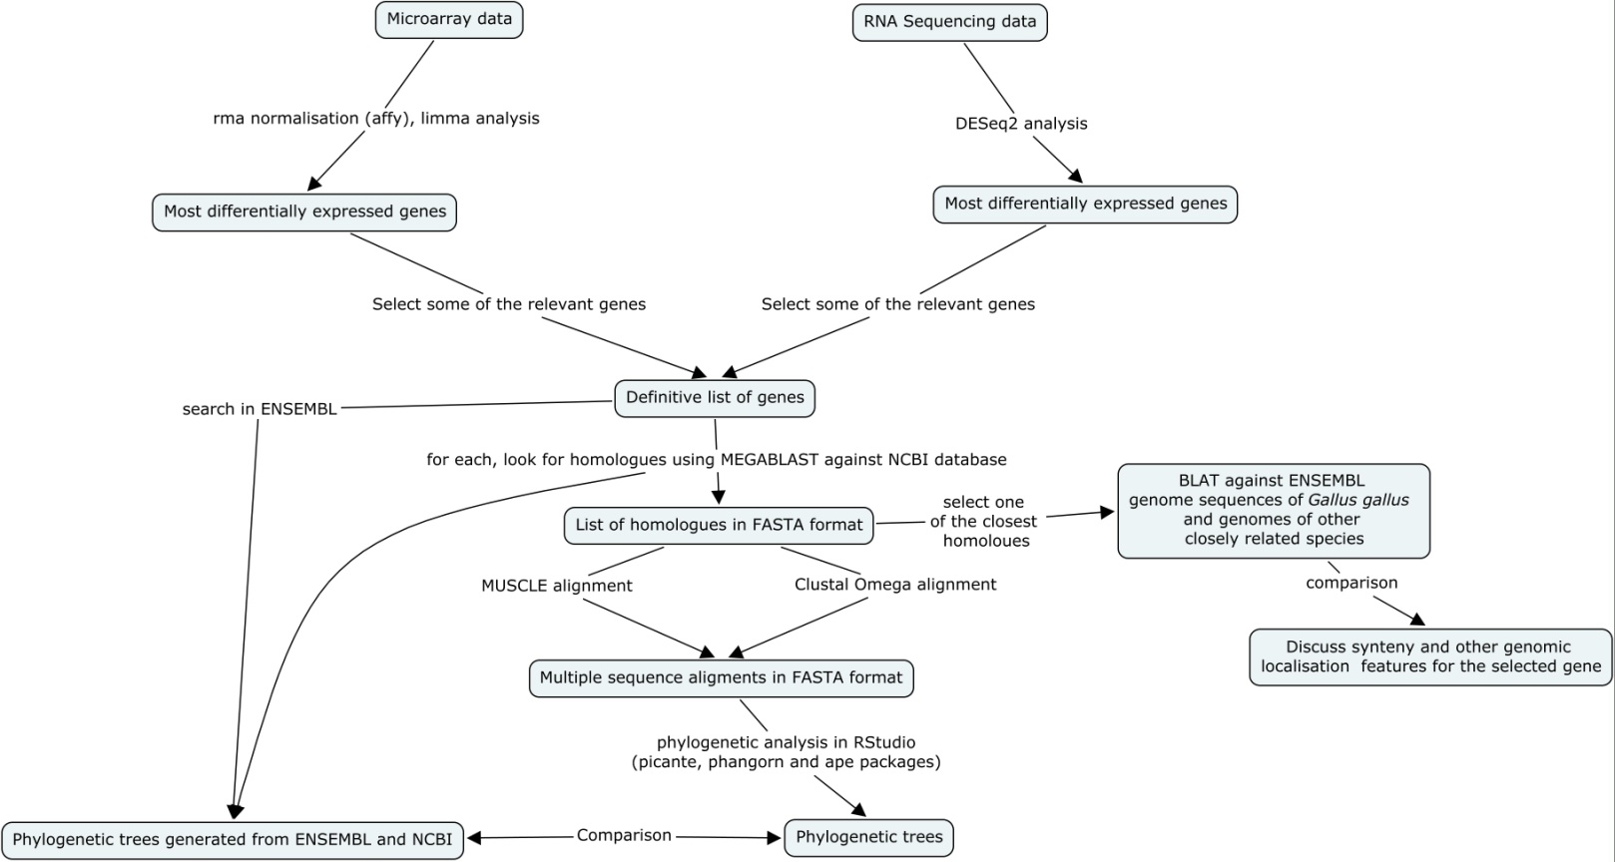

Slide 4
Identification of the most differentially expressed genes

Slide 6
List of genes
Microarray RNA-Sequencing

Slide 7
Homologues search and multiple sequence alignment

Slide 8
Nucleotide loci sequences
ENSEMBL sequences
Nucleotide mRNA sequences
Too long
Uncompleted

Slide 9
Find the mRNA sequence of MMEL1 and MUC6
Search homologues
(MEGABLAST against Nucleotide)
Download the sequences in FASTA file
MSA using Clustal Omega and MUSCLE
MUSCLE alignment and Clustal alignment for each gene

Slide 10
Tree building and phylogenetic analysis

Slide 11
Distance matrix using K80
NJ tree building
Model testing
Tree fitting with the new more suitable model and plotting
Bootstrapping

Slide 13
Things to be considered
Better genomic analysis
Protein alignment + tree
More practise (in all the fields)

